Slide 1
MODULE 4
DATA SCIENCE BOOTCAMP

Slide 2
Module Outline
Overview of Azure ML Studio
ML Process
Creating ML Models in Azure ML Studio

Slide 3
Azure ML Studio
Microsoft & Machine Learning
15 years of realizing innovation
1999
2004
2005
2008
2010
2012
2014
Computers work on users behalf, filtering junk email
Microsoft search engine built with machine learning
SQL Server enables data mining
Bing Maps ships with ML traffic-prediction service
Microsoft Kinect can watch users gestures
Successful, real-time, speech-to-speech translation
Microsoft launches Azure Machine Learning
Notes:
As early as 1999 they were using it to help create email filters by predicting which emails were junk, and which were relevant.
It is also used in Bing Maps as part of the traffic prediction service.
And many people know about how it was a key technology to make Kinect a reality, letting computers track people’s gestures and sort through what’s relevant and what’s not.
And today, this technology that has been developed over decades is becoming available commercially as part of Azure

Slide 4
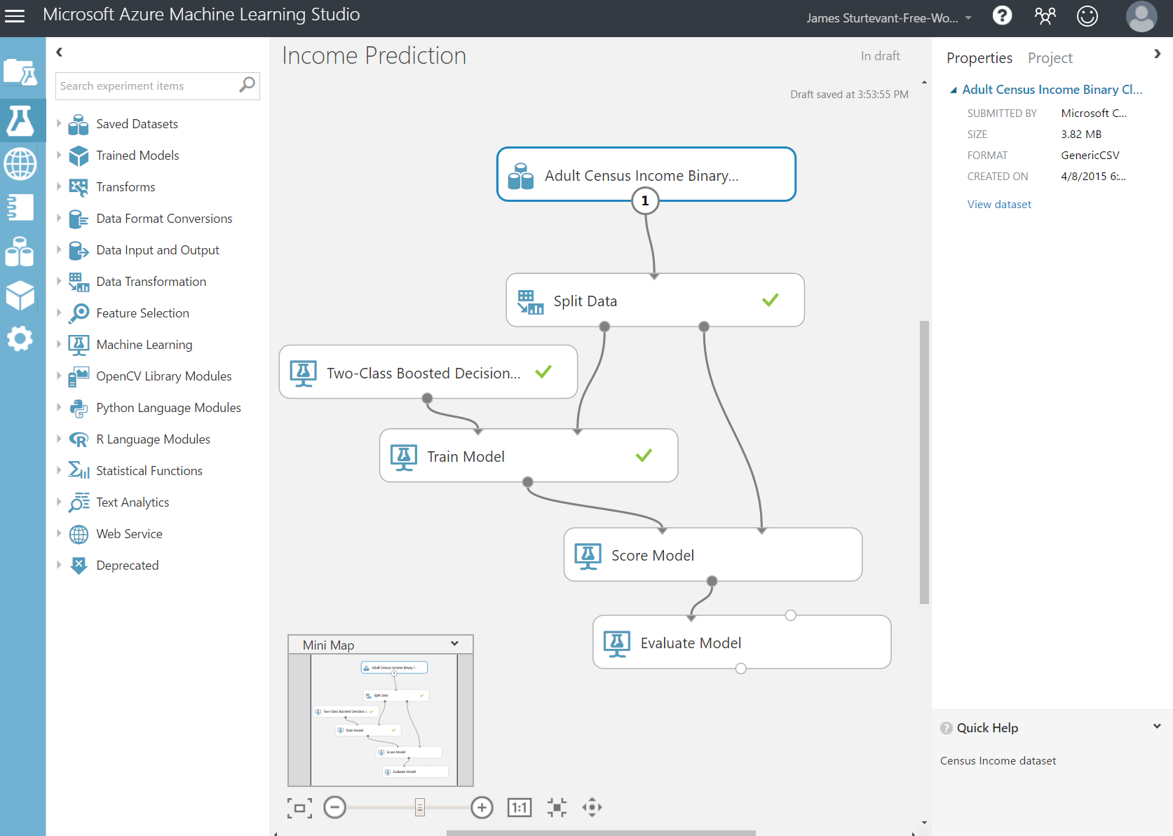
Azure ML Studio (Cont’d)
Cloud Based
ML Studio for composing models
Supports numerous input formats
Supports R and Python
Notes:
ML Studio simplifies machine learning by providing a drag-and-drop model in which you build workflow.
With ML Studio you can often build sophisticated models without writing a single line of code.
it allows you to insert R and Python code anywhere in the workflow

Slide 5
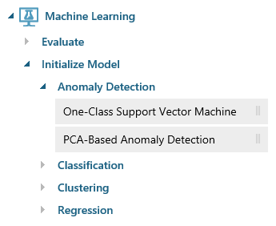
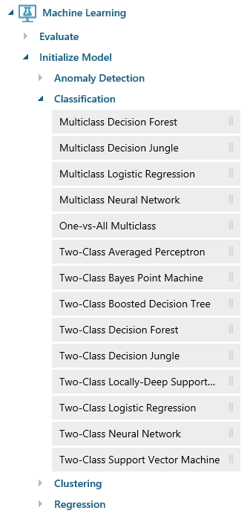
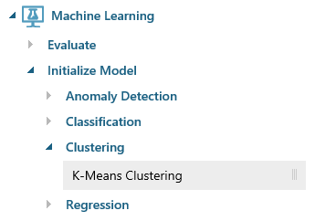
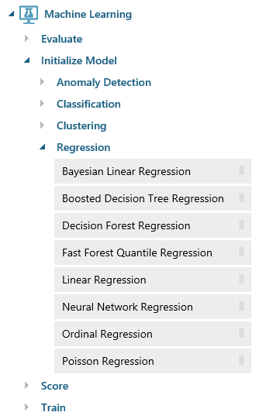
Azure ML Studio (Cont’d) ML Algorithms
Notes:
ML Studio provides canned implementations of 25 of the classic algorithms used in machine learning. It divides them into four categories.
Anomaly detection is the identification of items, events, or observations which do not conform to an expected pattern or other items in a dataset. A classic example is examining a dataset representing banking transactions and detecting potentially fraudulent transactions in that group.
Regression algorithms seek to establish and quantify relationships between variables. By establishing a relationship between a dependent variable and one or more independent variables, regression analysis can enable the value of a dependent variable to be predicted given a set of inputs with a quantifiable accuracy. A great example can be seen at https://how-old.net/#, a site that lets you upload a photo and then guesses your age with uncanny accuracy. The site uses Azure Machine Learning and combines classic regression with advanced image recognition.
The purpose of classification algorithms is to identify the category to which an observation belongs based on training data consisting of observations which have already been classified (assigned to a category). A great example is determining whether an e-mail belongs to the "spam" category or the "not-spam" category.
Clustering seeks to group a set of objects in such a way that objects in the same group (called a cluster) are more similar to each other than to those in other groups (clusters).

Slide 6
Machine Learning Process (Overview)
Notes:
Machine learning process cycle

Slide 7
ML Process – Business Understanding
Understand the project objectives and requirements
Can it be converted into a data mining problem
Were any effort made in the past? If yes, what were the findings? Why are we doing it again? What has changed?
Assess availability of time, technology and human resources. Do we have enough time and resources to execute the analytics project?
Identify the success criteria, key risks and major stake holders.
Notes:
Objectives & requirement
Efforts made earlier
Is it a data mining prob?
Time , technology req? human resource needed?

Slide 8
ML Process – Data Understanding
Get familiar with the data. Is it enough to solve the stated business problem? If not, do we need to redesign the data collection process?
What’s needed vs. what’s available
Identify data quality problems
Determine the structures and tools needed
Notes:
Data understanding .. Enough to solve business need
What needed vs available
Identify Data quality issues
Tools and structure needed to solve the prob

Slide 9
ML Process – Data Preparation
Tasks include attribute selection as well as transformation and cleaning of data
Understand what to keep and what to discard
Extensive use of exploratory data analysis and visualization
Process likely to be repeated multiple times
Notes:
Data preparations includes:
Attribute selection
Cleansing and transformation
What features to keep and discard
EDA and visualizations
Iterative process

Slide 10
ML Process – Modelling
Selection of Machine Learning Algorithm according to the business problem you are trying to solve
Train the model over training data
Predict the class label for the test data
Notes:
Selection of ML Algorithm according to problem they want to solve
In this regard azure provide nearly 25 different ML algorithms to deal with different kind of problems

Slide 11
ML Process – Evaluation
Test robustness of the models under consideration by gauging their performances against hold-out data.
Analyze if the models achieve the business objectives.
Notes:
Test model against unseen data
Analyze if model achieve the required business goals
If not , as it is an iterative process, you can go back either to data preparation or modelling step to make changes to meet business goals

Slide 12
ML Process – Deployment
Important for the customer to understand up front the actions needed to actually make use of the created models.
Define process to update and retrain the model, as needed
Notes:
Deployment ensures that the customer can utilize these prediction in the business applications they desire
You can set a time to reassess the model and make changes in the model if needed
In our case all of this is performed visually in ML Studio.
Once the model is ready, a few button clicks deploy it as a Web service so it can be called from client apps.

Slide 13
Creating ML Models In Azure ML Studio (Explore the data dictionary)
Go to the following github repository to download the LoanGrant_Data_Dictionary.docx
https://github.com/ahadmushir/MSDSBOOTCAMP
Notes:
- Make them read the data dictionary for Loan Grant problem.

Slide 14
Creating ML Models In Azure ML Studio
Make sure you already have an Azure ML Studio account.
Log on https://studio.azureml.net/

Slide 15
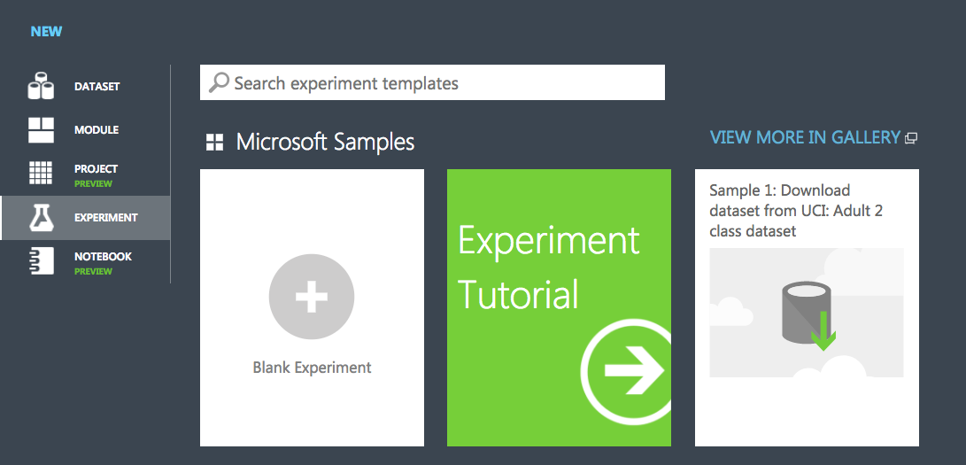
Creating ML Models In Azure ML Studio
Create a new blank experiment.
Notes:
These steps might have been covered in the previous module.

Slide 16
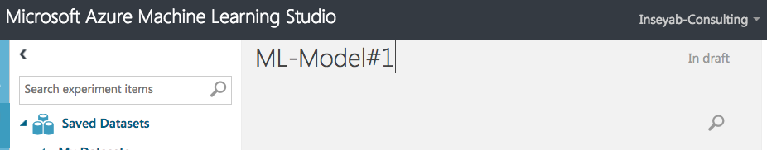
Creating ML Models In Azure ML Studio
Rename the experiment to ML-Model#1
Notes:
These steps might have been covered in the previous module.

Slide 17
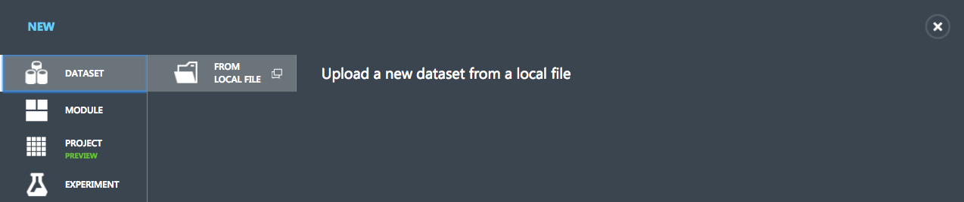
Creating ML Models In Azure ML Studio (Uploading your data)
Go to the following github repository to download the loangrant.csv
https://github.com/ahadmushir/MSDSBOOTCAMP
Upload the data in Azure ML Studio

Slide 18
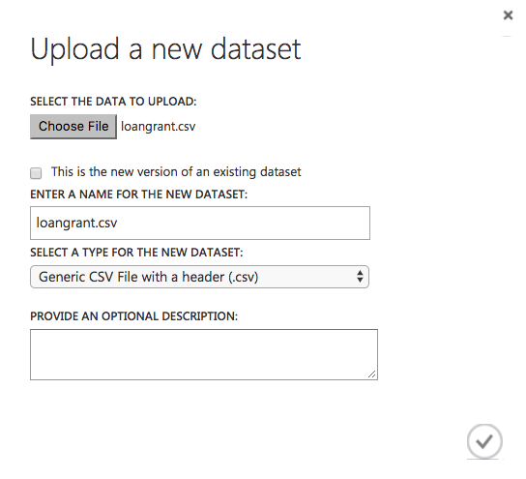
Creating ML Models In Azure ML Studio (Uploading your data)

Slide 19
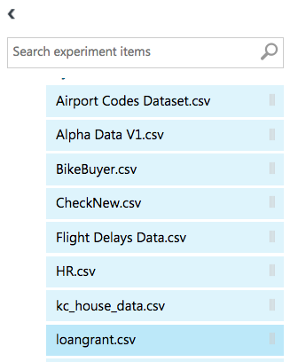
Creating ML Models In Azure ML Studio (Uploading your data)
Verify that your data is uploaded.
Notes:
Make them read the data dictionary too

Slide 20
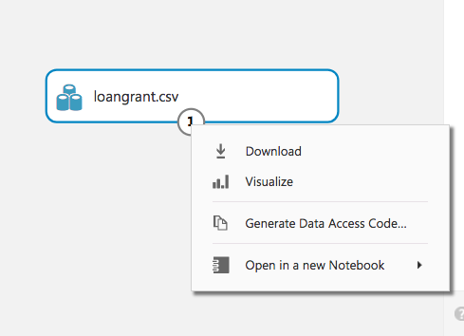
Creating ML Models In Azure ML Studio (Explore your data)
Right click on the dataset module.

Slide 21
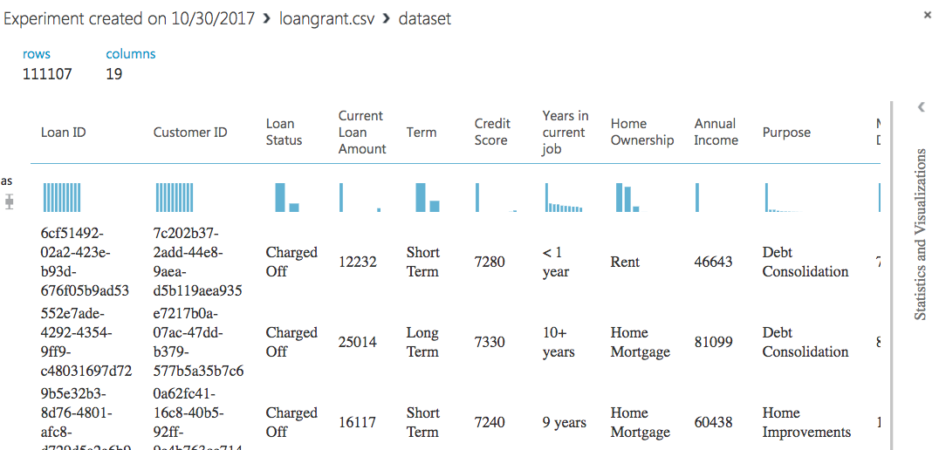
Creating ML Models In Azure ML Studio (Explore your data)
Explore your dataset and its distributions.

Slide 22
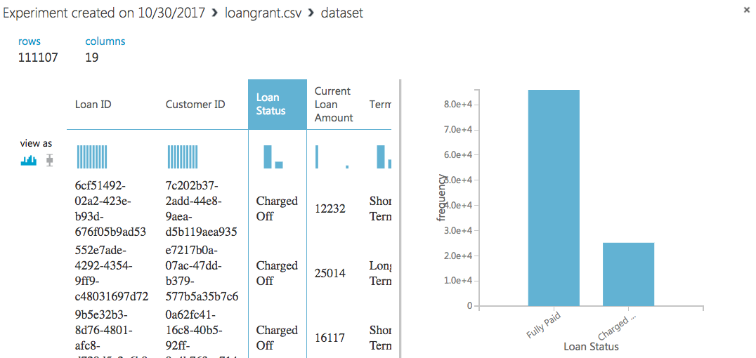
Creating ML Models In Azure ML Studio (Explore your data)
Explore your class label and its distributions.
Notes:
Loan Status → Class Label (discuss class label)
After that make them explore each and every other column along with their feature data-type and distribution
Making them identify the type of pre-processing they might need to do.
Identify them Unique values of Loan ID

Slide 23
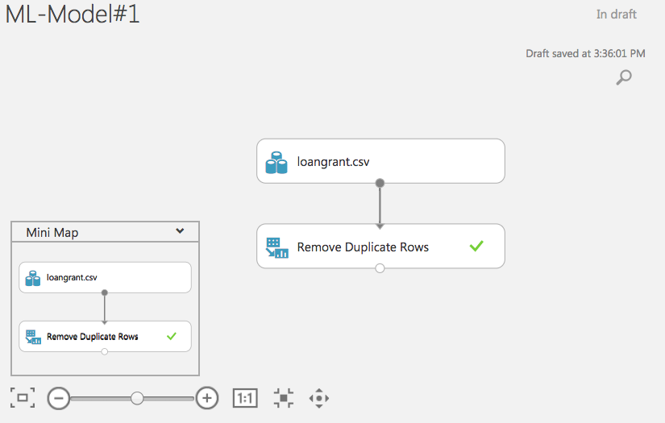
Creating ML Models In Azure ML Studio (Removing Duplicates)
Removing Duplicate Values on the basis of Loan ID.
Notes:
- Remove duplicates
Make them save the model before moving to the next slide.

Slide 24
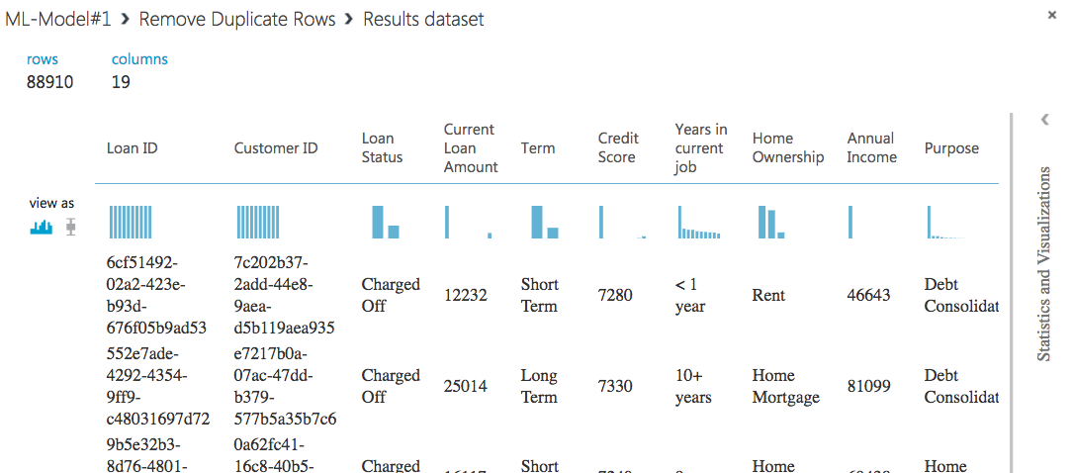
Creating ML Models In Azure ML Studio (Removing Duplicates)
Explore the data.
Notes:
- Now few rows are eliminated. (Notify them)

Slide 25
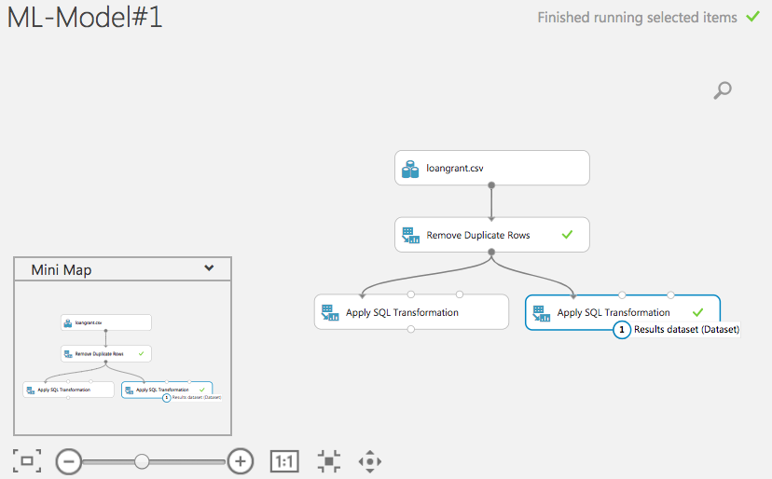
Creating ML Models In Azure ML Studio (Handling “Credit Score”)
Introducing “Apply SQL Transformation” module.
Apply SQL syntax to your dataset.
No need of any other IDE.
Notes:
Observe Credit score column and make them refer to data dictionary
Tell them to add one module after the other.
By default SQL => “select * from t1;”

Slide 26
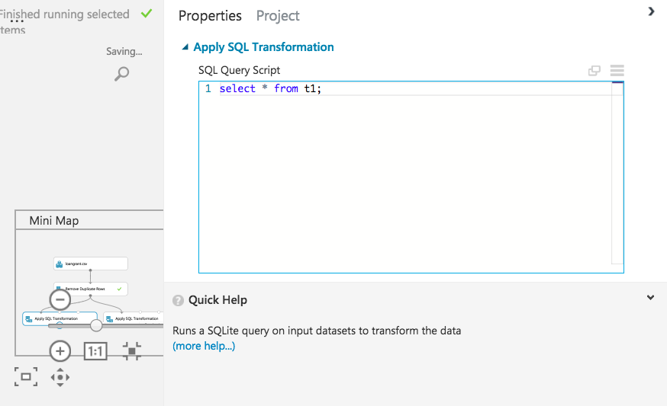
Creating ML Models In Azure ML Studio (Handling “Credit Score”)
Notes:
The first SQL TRANSFORM module. (simple select statement).

Slide 27
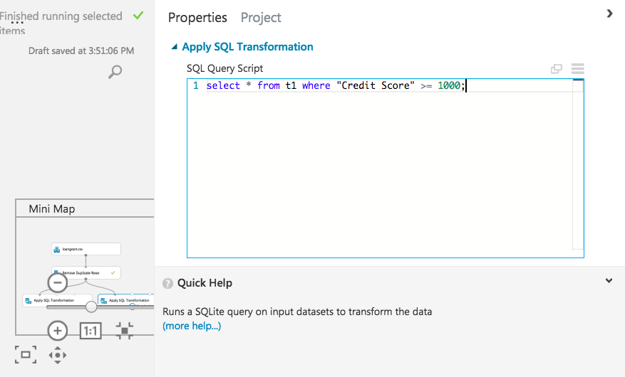
Creating ML Models In Azure ML Studio (Handling “Credit Score”)
Notes:
The second SQL TRANSFORM module. (Selecting Credit Score values greater than 1000).
Explain them the reason for doing this step.
Refer back to the data dictionary.

Slide 28
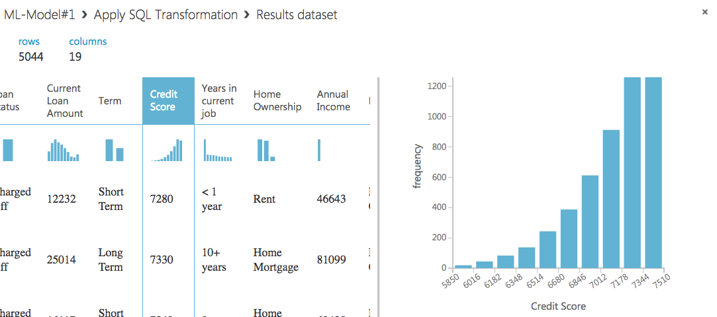
Creating ML Models In Azure ML Studio (Handling “Credit Score”)
Notes:
OUTPUT: The second SQL TRANSFORM module. (Selecting Credit Score values greater than 1000).
Confirm them the results.

Slide 29
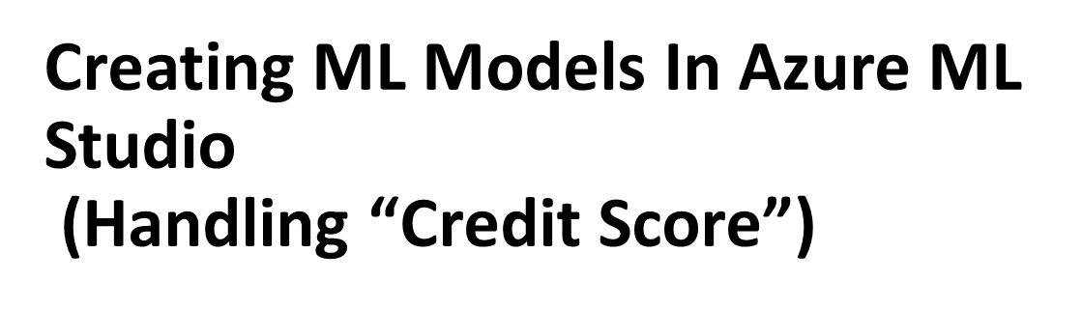
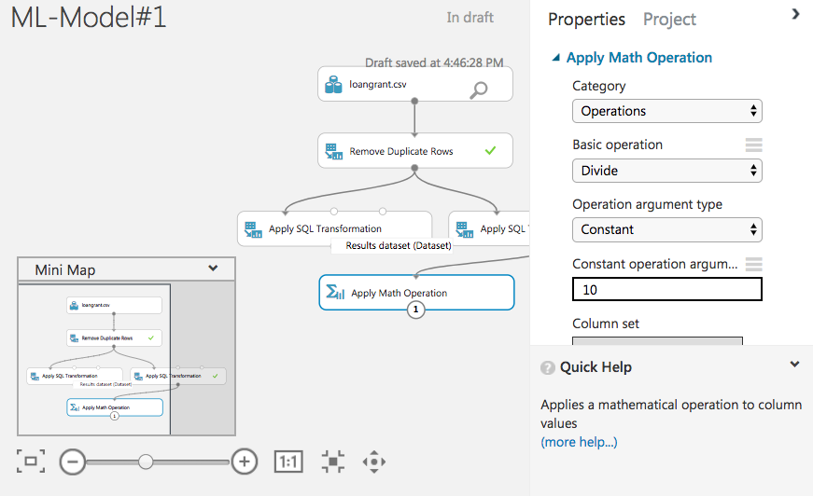

Slide 30
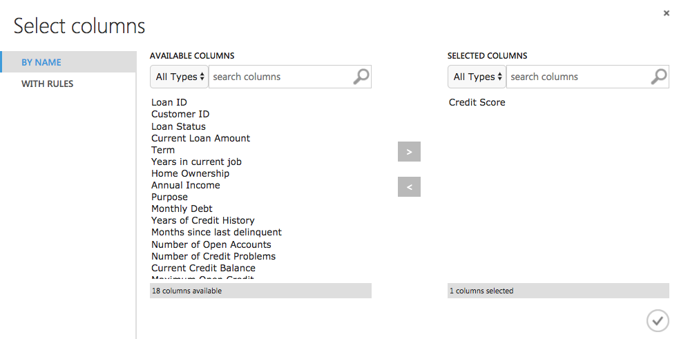
Notes:
Select “Credit Score” column from the column selector.

Slide 31
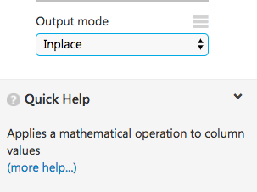
Creating ML Models In Azure ML Studio (Handling “Credit Score”)
Ensure that the output mode is “InPlace”.

Slide 32
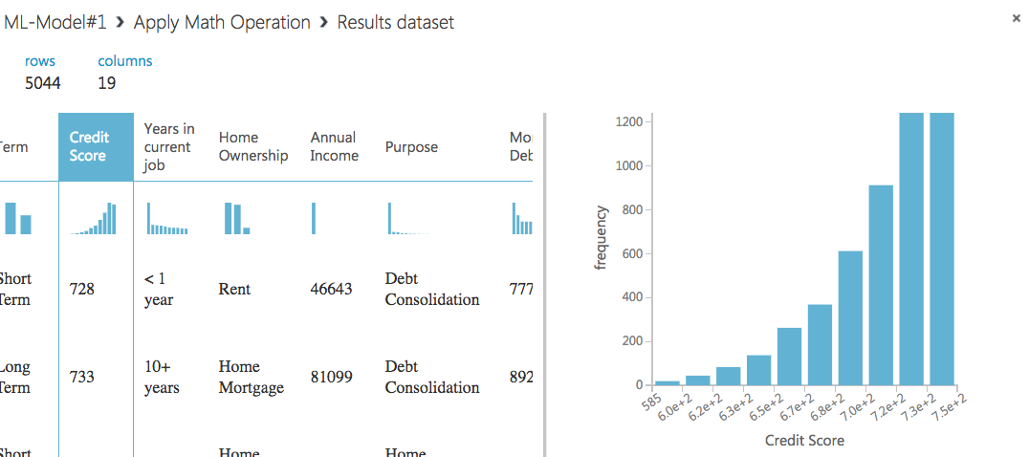
Creating ML Models In Azure ML Studio (Handling “Credit Score”)
Notes:
Verify the output.

Slide 33
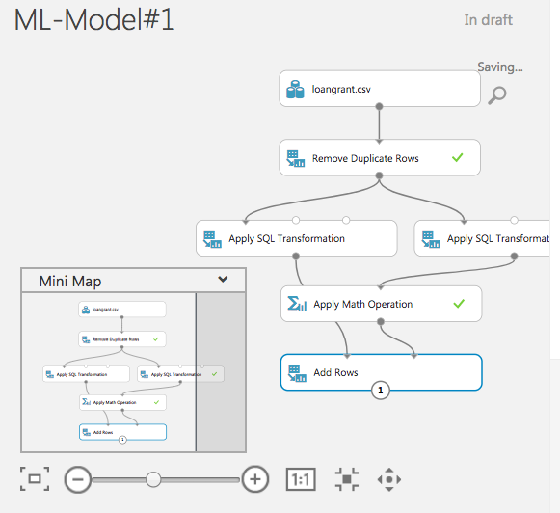
Creating ML Models In Azure ML Studio (Handling “Credit Score”)
Adding transformed data back to original dataset.
Notes:
“Add Rows” module.
Make sure the sql transform connect withr left and add maths with the right

Slide 34
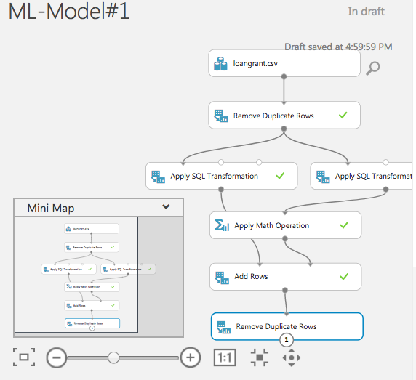
Creating ML Models In Azure ML Studio (Handling “Credit Score”)
Since we have just simply added rows, we definitely have duplicate records.
Notes:
Removing the duplicates which we created, having the wrong version of “Credit Score”.

Slide 35
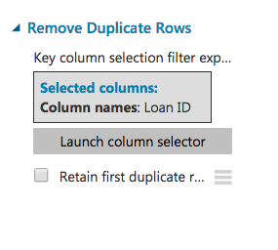
Creating ML Models In Azure ML Studio (Handling “Credit Score”)
Ensure to uncheck the “Retain First Duplicate”.
Notes:
Explain the reason.

Slide 36
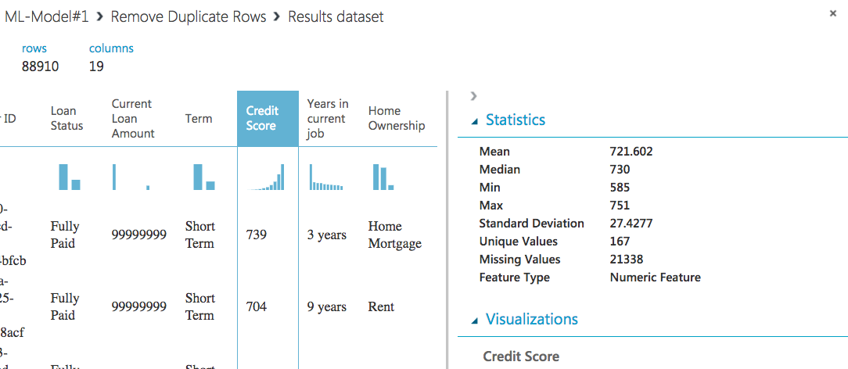
Creating ML Models In Azure ML Studio (Handling “Credit Score”)
Notes:
Verify the output.

Slide 37
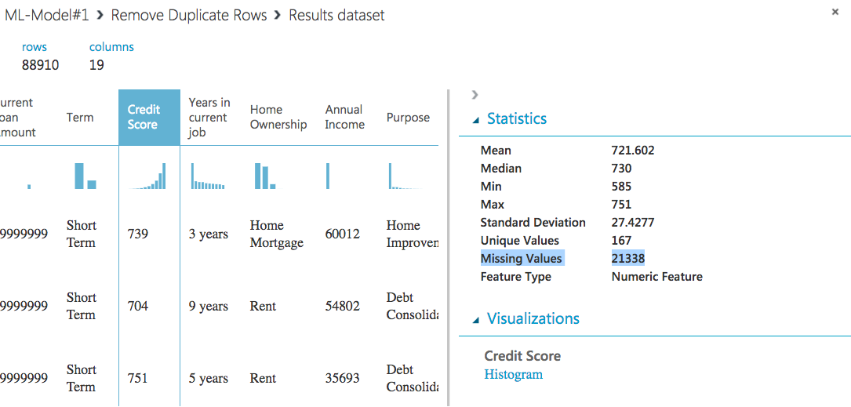
Creating ML Models In Azure ML Studio (Handling “Credit Score”)
Notes:
Handling missing values.

Slide 38
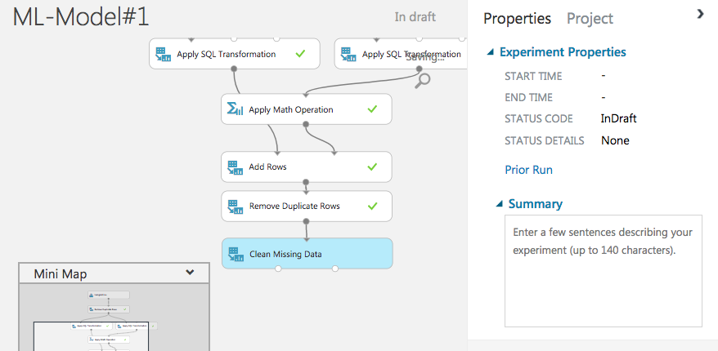
Creating ML Models In Azure ML Studio (Handling “Credit Score”)
Notes:
Showing them the components.

Slide 39

Creating ML Models In Azure ML Studio (Handling “Credit Score”)
Notes:
Column selector.

Slide 40
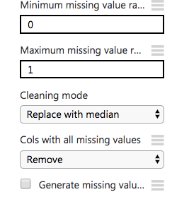
Creating ML Models In Azure ML Studio (Handling “Credit Score”)
Ensure to replace with Median.
Notes:
Ensure to replace with “Median”.
Explain them the reasoning.
Because of their distribution and mean would be influenced by the outliers

Slide 41
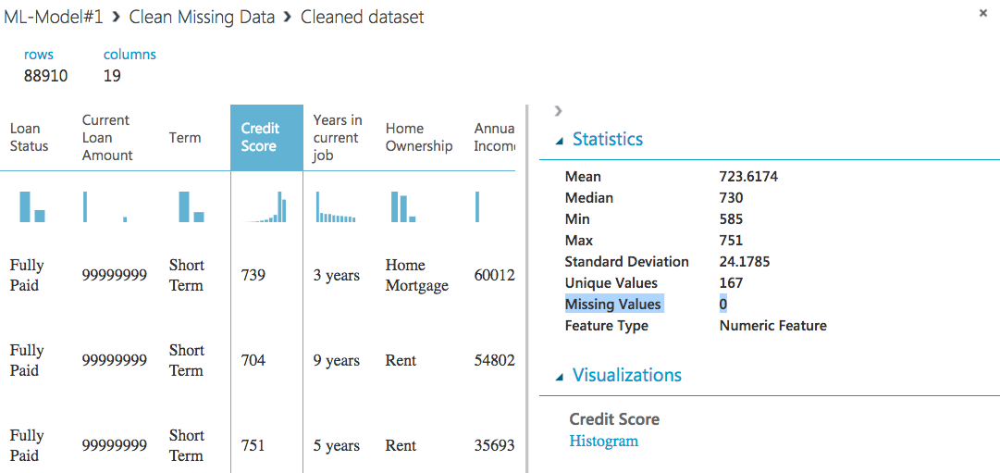
Creating ML Models In Azure ML Studio (Handling “Credit Score”)
Notes:
Verify the output.

Slide 42
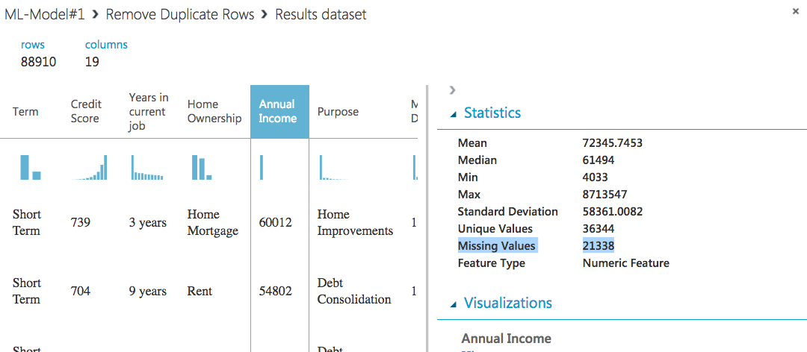
Creating ML Models In Azure ML Studio (Handling “Annual Income”)
Notes:
Observe the missing values, which we cant prune.
Hence we need to replace those missing values to avoid the loss of our data.

Slide 43

Creating ML Models In Azure ML Studio (Handling “Annual Income”)
Notes:
Using the “Clean Missing Data” module.

Slide 44
Creating ML Models In Azure ML Studio (Handling “Annual Income”)
Ensure to replace with Median.
Notes:
Ensure to replace with “Median”.
Explain them the reasoning.

Slide 45
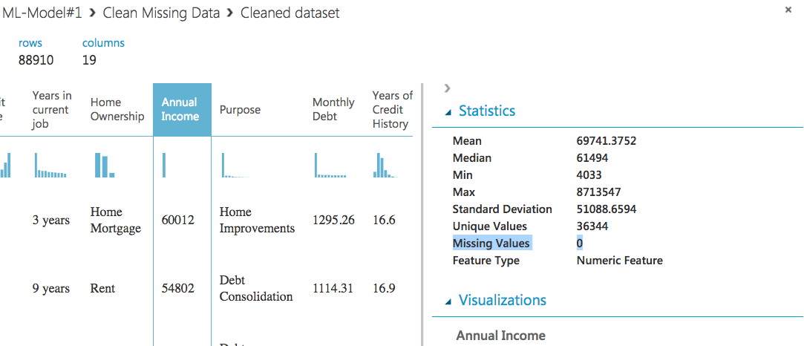
Creating ML Models In Azure ML Studio (Handling “Annual Income”)
Notes:
Verify the output.

Slide 46
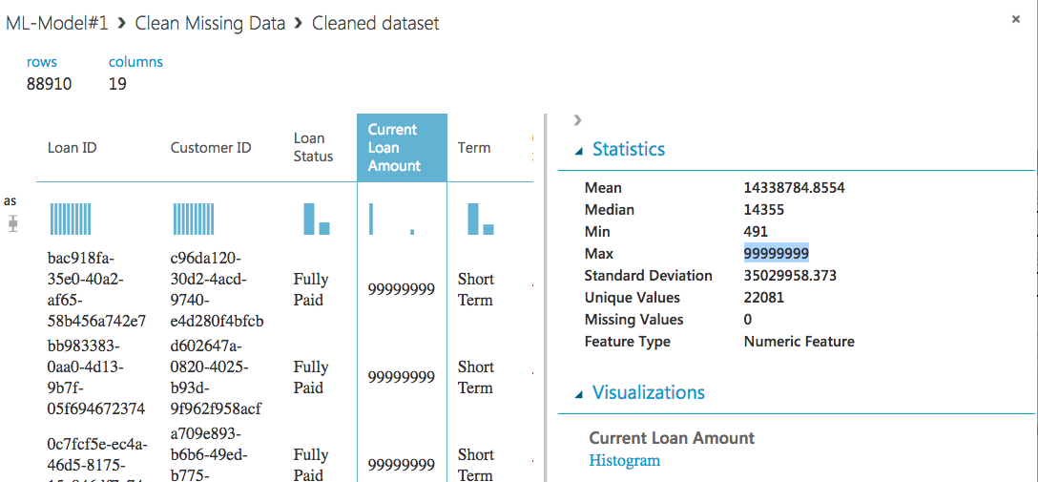
Creating ML Models In Azure ML Studio (Handling “Current Loan Amount”)
Notes:
Identify the problem.

Slide 47
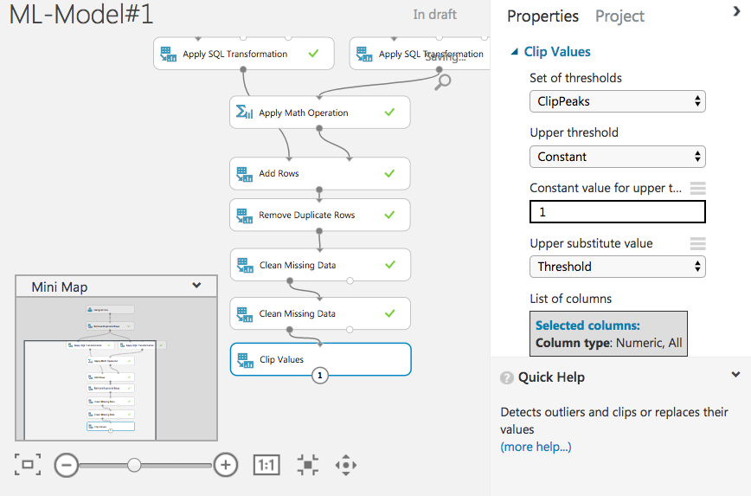
Creating ML Models In Azure ML Studio (Handling “Current Loan Amount”)
Notes:
Using the “Clip Peak Values” module.

Slide 48
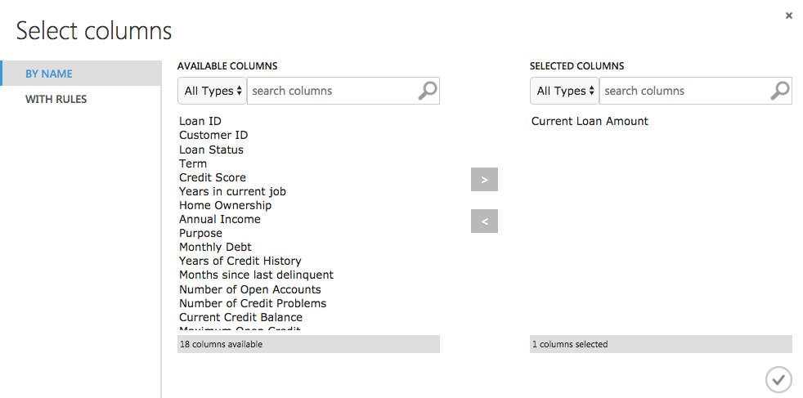
Creating ML Models In Azure ML Studio (Handling “Current Loan Amount”)
Notes:
Using the “Clip Peak Values” module.

Slide 49
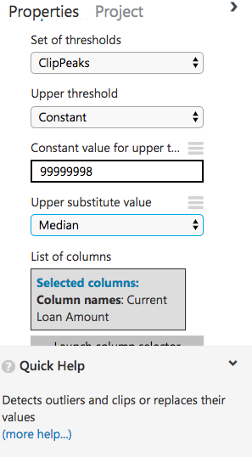
Creating ML Models In Azure ML Studio (Handling “Current Loan Amount”)
Ensure the following properties.

Slide 50
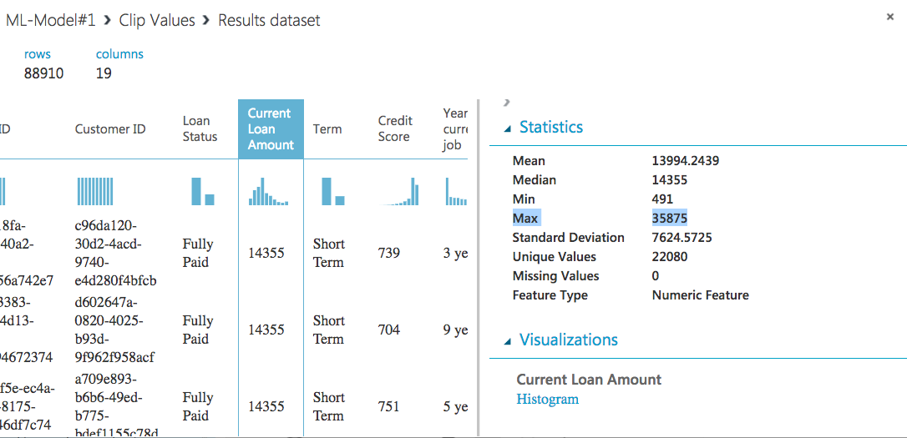
Creating ML Models In Azure ML Studio (Handling “Current Loan Amount”)
Notes:
Verify the output.

Slide 51
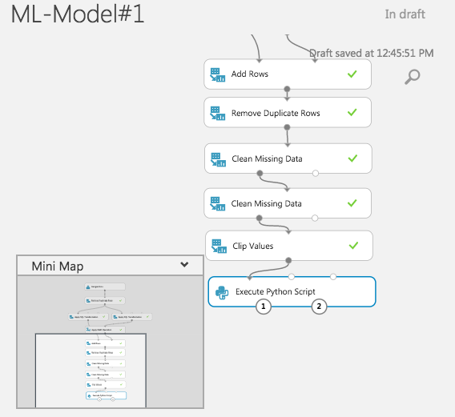
Creating ML Models In Azure ML Studio (Handling Features with Python Module)

Slide 52
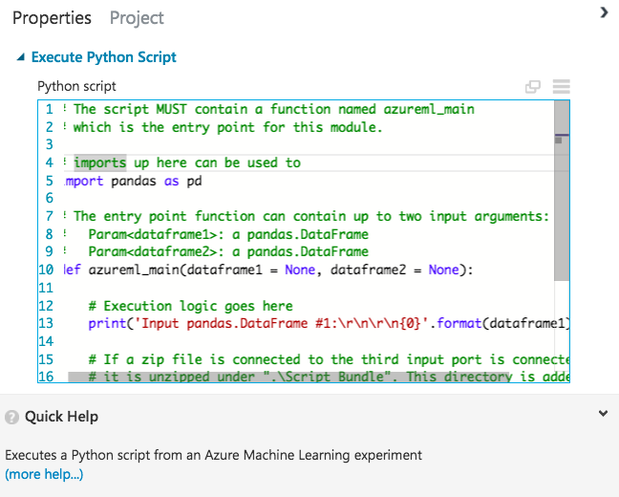
Creating ML Models In Azure ML Studio (Handling Features with Python Module)
Notes:
Show them the default code.

Slide 53
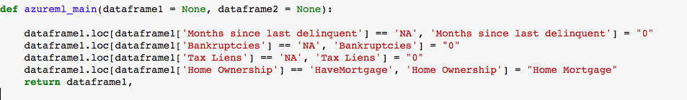
Creating ML Models In Azure ML Studio (Handling Features with Python Module)
Notes:
Explain our code logic.
Columns being affected are:
Months Since Last Delinquent -> NA to 0
Bankruptcies -> NA to 0
Tax Liens -> NA to 0
Home Ownership -> “HaveMortgage” & “Home Ownership” attributes to just “Home Mortgage”.

Slide 54
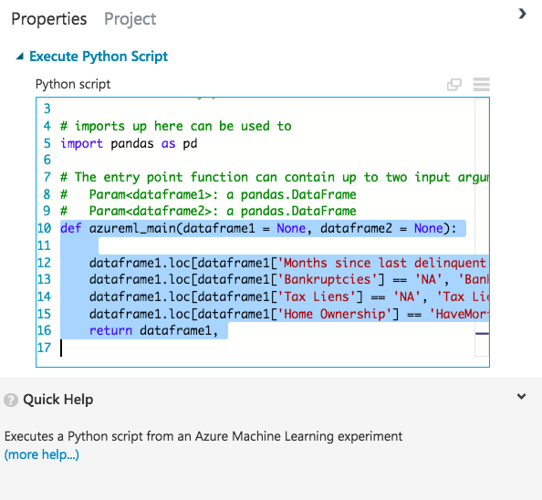
Creating ML Models In Azure ML Studio (Handling Features with Python Module)

Slide 55
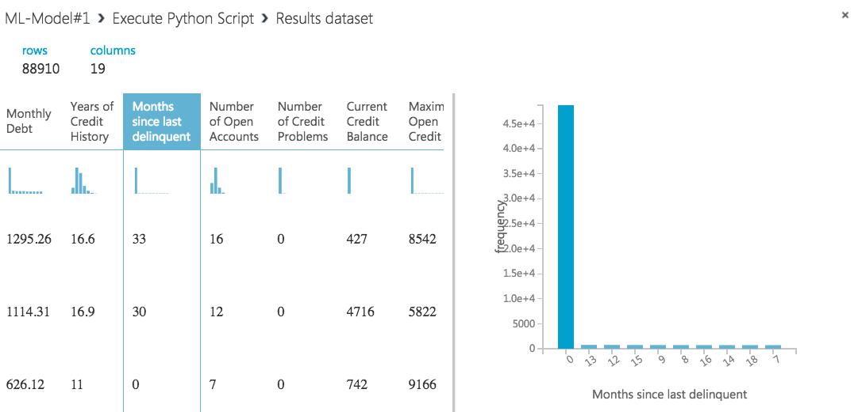
Creating ML Models In Azure ML Studio (Handling Features with Python Module)
Notes:
Verify the output.
Check all the features which were affected.

Slide 56
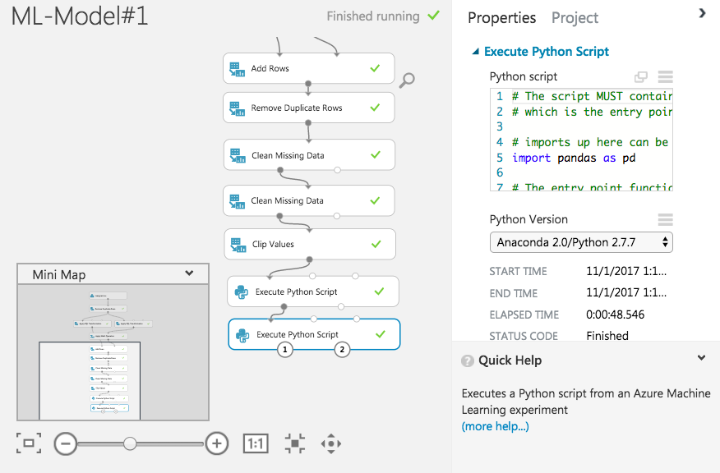
(Handling Features with Python Module: Converting Data Type)
Creating ML Models In Azure ML Studio
Notes:
Same procedure for different column, (converting the datatypes)

Slide 57
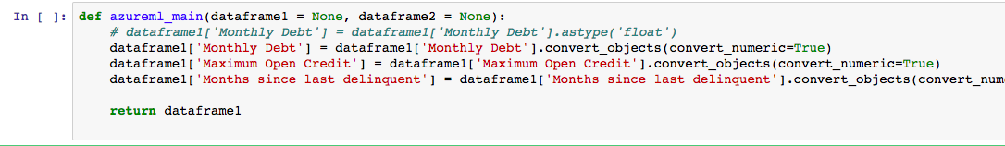
(Handling Features with Python Module: Converting Data Type)
Creating ML Models In Azure ML Studio
Notes:
Same procedure for different column, (converting the datatypes)
Verify the output.
Check all the features which were affected.

Slide 58
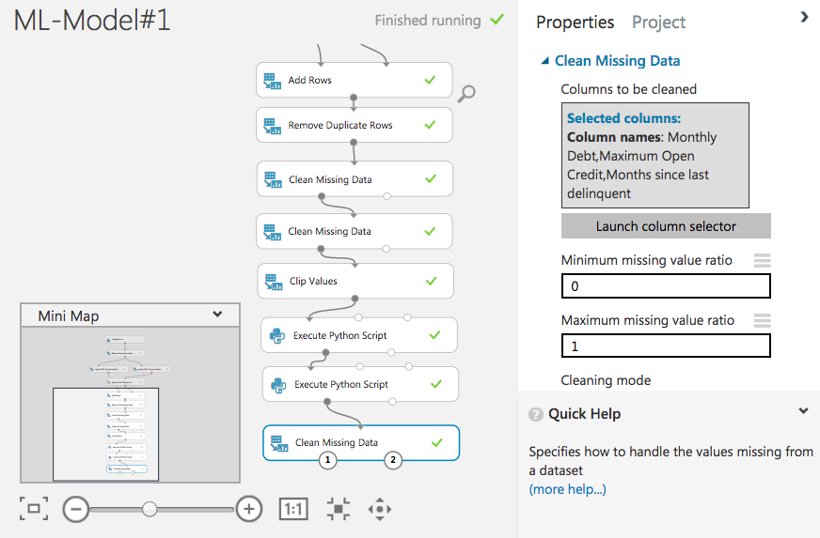
(Handling Features with Python Module: Converting Data Type)
Creating ML Models In Azure ML Studio
Clean missing values created when converting to numeric values.
Notes:
Clean missing data produced from converting to numeric values.
REMOVE THE ROWS. (Few in number)

Slide 59
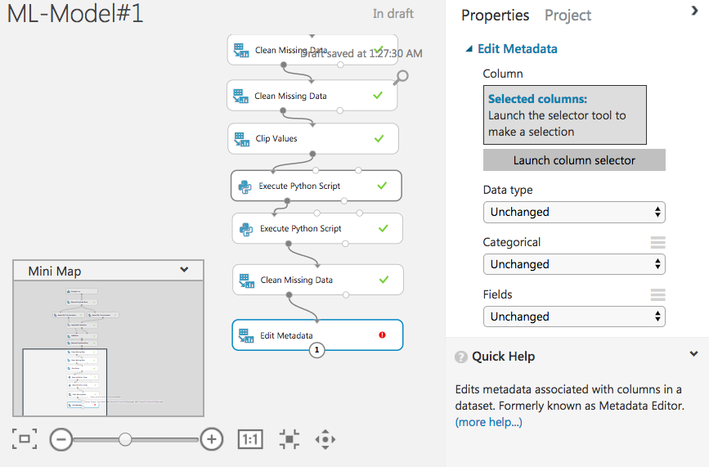
(Handling Features with “Edit Metadata”)
Creating ML Models In Azure ML Studio
Notes:
Using ”Edit metadata”.

Slide 60
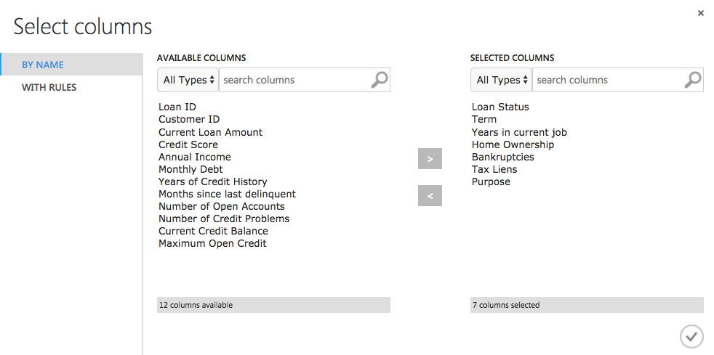
(Handling Features with “Edit Metadata”)
Creating ML Models In Azure ML Studio
Notes:
Using ”Edit metadata”.

Slide 61
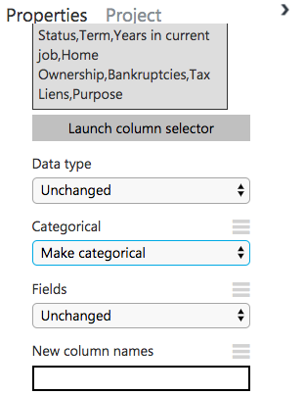
(Handling Features with “Edit Metadata”)
Creating ML Models In Azure ML Studio
Ensure the following properties.
Notes:
Using ”Edit metadata”.

Slide 62

(Handling “Years In Current Job”)
Creating ML Models In Azure ML Studio
Using “Grouping Categorical Values” component.
Notes:
Identify them the need for doing this by observing the data.

Slide 63

(Handling “Years In Current Job”)
Creating ML Models In Azure ML Studio

Slide 64



(Handling “Years In Current Job”)
Creating ML Models In Azure ML Studio
Notes:
Ensure the following properties.

Slide 65

(Handling “Years In Current Job”)
Creating ML Models In Azure ML Studio
Notes:
Verify the output.

Slide 66

(Splitting Data)
Creating ML Models In Azure ML Studio
Splitting data into Test and Training dataset.
Split on the basis of 70% training to 30% testing dataset.
Notes:
Verify the output.

Slide 67

Creating ML Models In Azure ML Studio
(Selecting ML Algorithm)
Using ML model of “Two Class Boosted Decision Tree”.
Notes:
A boosted decision tree is an ensemble learning method in which the second tree corrects for the errors of the first tree, the third tree corrects for the errors of the first and second trees, and so forth. Predictions are based on the entire ensemble of trees together that makes the prediction.
- Weighted sample
Ensemble learning helps improve machine learning results by combining several models. This approach allows the production of better predictive performance compared to a single model.
Bagging ensemble avg taken

Slide 68

(Add Hypertuning Parameters)
Creating ML Models In Azure ML Studio
Notes:
this module performs a parameter sweep over the specified parameter settings, and learns an optimal set of hyperparameters, which might be different for each specific decision tree, dataset, or regression method. The process of finding the optimal configuration is sometimes called tuning.
the module will randomly select parameter values over a system-defined range. You must specify the maximum number of runs that you want the module to execute. This option is useful for cases where you want to increase model performance using the metrics of your choice but still conserve computing resources.

Slide 69

(Evaluation Metrics)
Creating ML Models In Azure ML Studio
Confusion Matrix
In this example of a confusion matrix, among the 50 data points that are classified, 45 ae correctly classified and the 5 are misclassified.

Slide 70
(Evaluation Metrics)
Creating ML Models In Azure ML Studio
True Positive Rate (TPR), known as sensitivity, which is defined as TP/(TP + FN).
False Positive Rate (FPR), which is defined as FP/(FP + TN).

Slide 71

(Evaluation Metrics)
Creating ML Models In Azure ML Studio
Notes:
ROC Curve and AUC.
Don’t need to calculate these values.

Slide 72

(Score & Evaluate Model)
Creating ML Models In Azure ML Studio
Notes:
Takes a little time to perform.

Slide 73

(Score & Evaluate Model)
Creating ML Models In Azure ML Studio
Notes:
Takes a little time to perform.

Slide 74

Creating ML Models In Azure ML Studio
ROC Curve

Slide 75
END OF MODULE 4

